Slide 1
Shell Bootcamp 2024 3 Reflections for Week #1
Chitteshwari Satish
Date : 30-Aug-2024

Slide 2

About Me
“If you’re going through hell, keep going”

Slide 3

My learnings from this week!

Slide 4
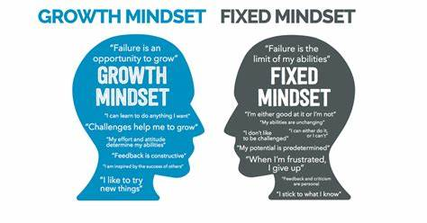
Learning 1 | My takeaways
Professionalism and Growth Mindset
The importance of good communication
Conflict management
The art of Networking
Fixed mindset vs growth mindset
Professionalism in various corporate settings
How to transition from college campus to corporate

Slide 5
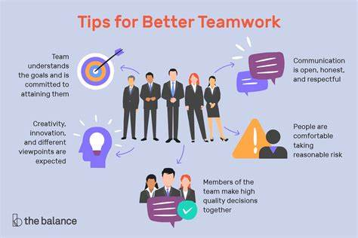
Learning 2 | My takeaways
Teamwork and Stakeholder Management
How to effectively work in a team and qualities of a good team player
How to make a good presentation and present it as a team
The role of various stakeholders in a project through live roleplay wrt the energy sector
Practical understanding of how to work through various conflict situations in a team
How to manage and negotiate opposing interests amongst stakeholders

Slide 6
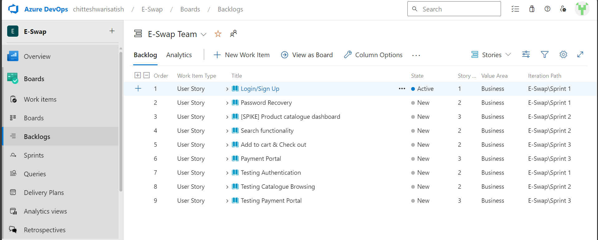
Learning 3 | My takeaways
Business Analysis and Agile Methodology
What is Business Analysis and the extent of its scope
Requirement Analysis and their types (functional and non-functional)
SDLC
Waterfall and Agile models
Azure DevOps through hands-on learning

Slide 7

Relevance of learnings for my organization

Slide 8
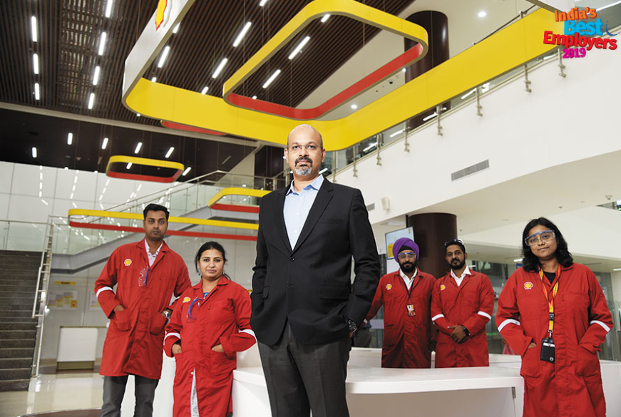
Learning 1 | Relevance for Shell
Soft skills such as professionalism, organization, teamwork and communication enhance the working efficiency for both the company and its employees.
This is particularly crucial for a global company like Shell where individuals from very diverse backgrounds are present. These abilities enable employees to be more productive and consistently meet Shell values and deadlines since all communication is done with respect and professionalism.

Slide 9
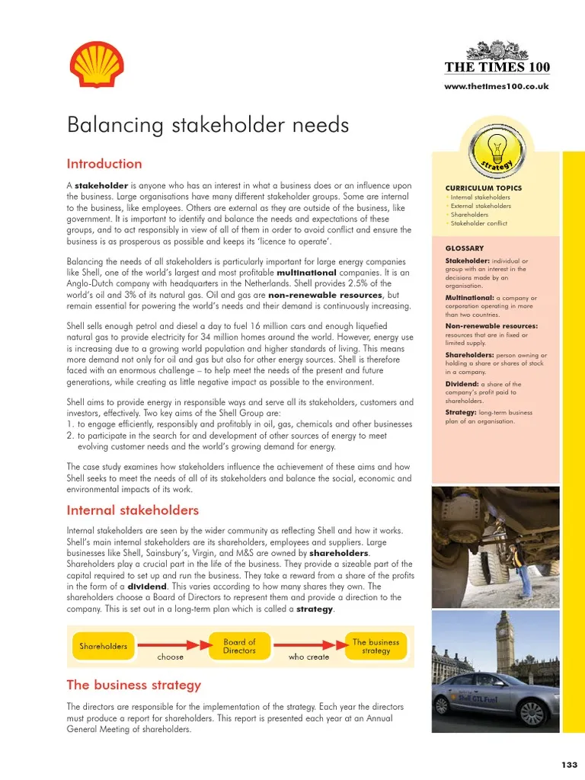
Learning 2 | Relevance for Shell
Effective teamwork is essential for a global company like Shell since teams consist of members from different continents, coming from various backgrounds and levels of experience. Considering the magnitude of the projects, it is important that employees are good team members so that conflicts can be professionally resolved without impacting the quality of work.
Stakeholder management is also crucial to understand since an energy company of this scale which includes both upstream and downstream business has various stakeholders with different interests involved which need to be managed effectively.

Slide 10
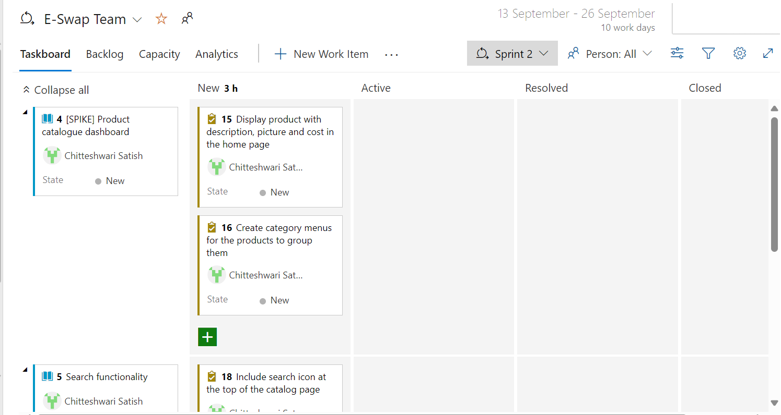
Learning 3 | Relevance for Shell
Business analysis is necessary because the requirements of the project has to be understood thoroughly before it reaches the design or development stages. This is to be effectively communicated and documented to all involved parties otherwise the client’s problems would not be effectively solved.
Concepts like Agile methodology are relevant since the energy industry is a highly transformative one with changing requirements that must be iteratively updated in order to stay up to date with the trends in the energy sector.
chitteshwari/Shell_training: This repository has the Journey PPT & hands-on project links for the Shell-UNext Training Bootcamp (github.com)

Slide 11

Challenges in implementing learning

Slide 12
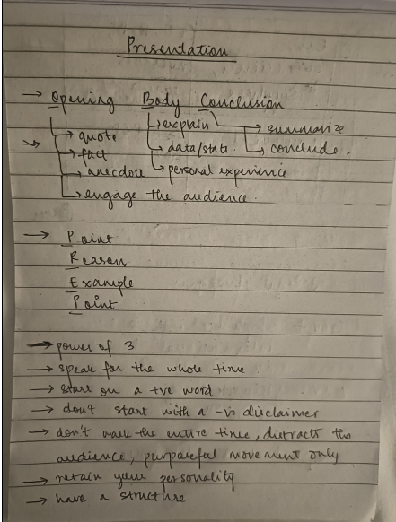
Challenge faced while implementing Learning 1
The main challenge was in transitioning our mindset from a college centric one to a corporate one, including using more professional language. However, the use of various activities like team brainstorming, roleplay and games made the understanding very easy.

Slide 13
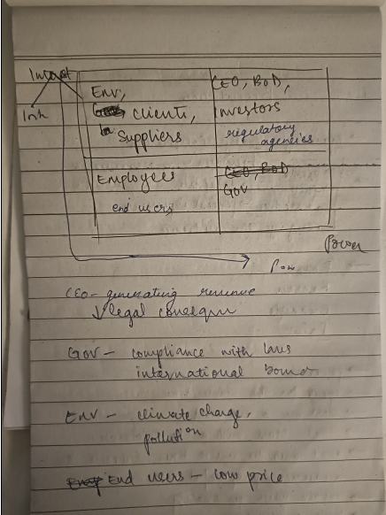
Challenge faced while implementing Learning 2
The main challenge with teamwork was learning to work in big groups with various conflicting ideas being put out during the activities. However, with the soft skills training, we were able to overcome them in a professional manner and learn about how to navigate such situations.

Slide 14
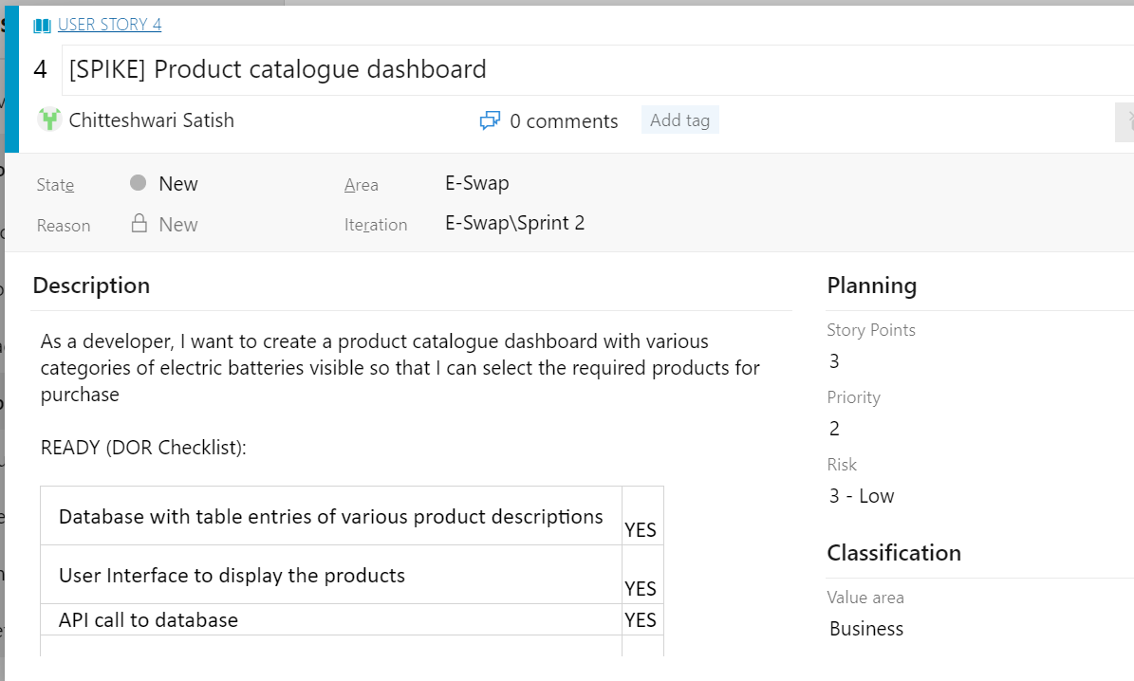
Challenge faced while implementing Learning 3
The primary challenge was understanding how Azure DevOps works since it was a very fresh concept. However, the hands-on learning experience made the process much smoother and we were able to grasp the workings of the tool by the end of the sessions.
chitteshwari/Shell_training: This repository has the Journey PPT & hands-on project links for the Shell-UNext Training Bootcamp (github.com)

Slide 15

Action Plan

Slide 16
My Action Plan for this Week
Actions
Timeline
Status
1: Continue to speak in a professional manner with colleagues to adapt to it better.
2: Implement more user stories and tasks in Azure DevOps to have a better practical understanding of it.
Action 1: 31/08/24
Action 2: 01/09/24
Actively learning

Slide 17

Learning is also Fun!

Slide 18
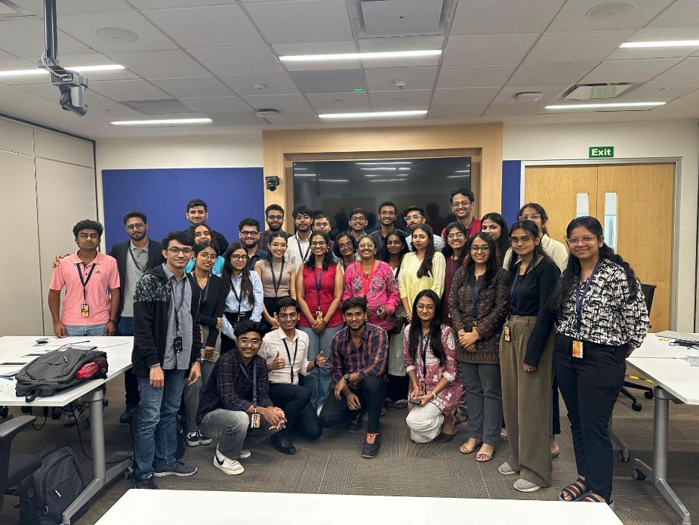
Learning is also Fun!
A lot of fun activities made the sessions very engaging:
Roleplay activities for stakeholder management and growth mindset concepts
Team presentation during soft skills
Games conducted to demonstrate importance of communication in team work

Slide 19

Summary
Learnt about various soft skills through various activities. Skills learnt were professionalism, communication, teamwork, presentation and stakeholder management, among others.
Learnt about business analysis along with requirement management, software development life cycle, waterfall and agile frameworks, and Azure DevOps through hands-on learning.
These learnings would act as a foundation for navigating through further topics such as Cloud DevOps and software engineering training. Soft skills learnt would go a long way in the entire corporate career at Shell.
The learnings from each day were interconnected; the previous skills acquired helped in imbibing the next set of skills each day. The concepts of stakeholder management taught during soft skills also helped in navigating requirement management of stakeholders during the business analysis training.

Slide 20
Thank You

